Slide 1

Benchmarking ECG Classification
Prepared for: Dr. Muhammad Hasan, Associate Prof. Sonny Pham
Prepared by: Tien Thinh Nguyen
Date: 05/05/2025

Slide 2
Introduction - Problem Statement & Objectives
Address Concerns from Last Week:
Research and Clearly Understand Abnormal Cardiovascular Conditions and Their ECG Characteristics
Research and Find Algorithms to detect these Abnormal ECG Characteristics
Continue finding and benchmarking ECG Classification Model

Slide 3
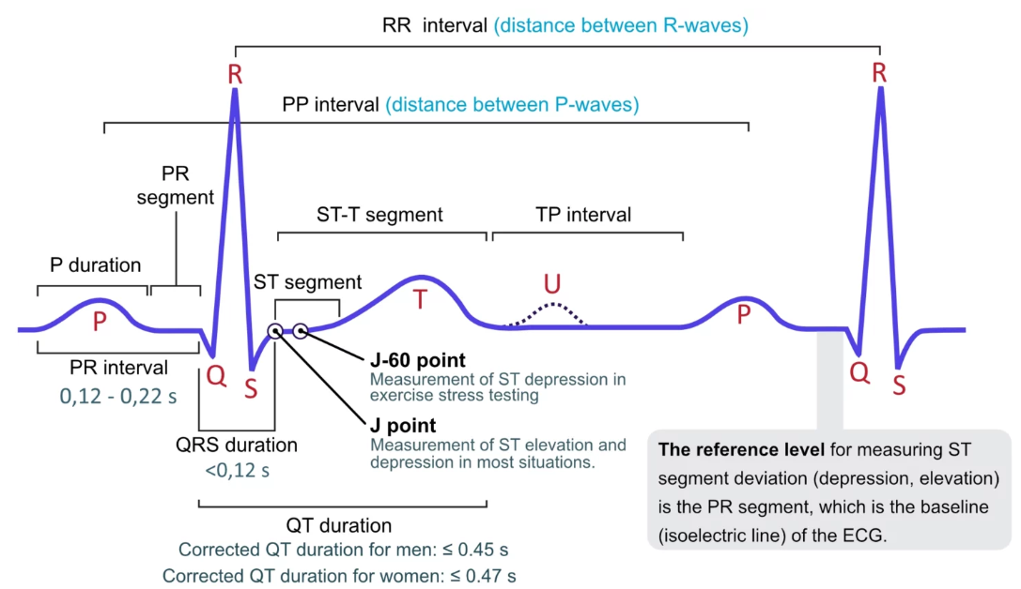
Normal Sinus Rhythm
P Wave:
Represents Atrial Depolarization – the electrical activation spreading across the atria, causing them to contract.
PR Interval:
Measures the time from the start of atrial depolarization (start of P wave) to the start of ventricular depolarization (start of QRS complex).
Includes the delay at the AV node, allowing ventricles to fill.
QRS Complex:
Represents Ventricular Depolarization – the rapid electrical activation spreading through the ventricles, causing them to contract (systole).
Its larger size reflects the greater muscle mass of the ventricles compared to the atria.
ST Segment:
The interval between ventricular depolarization and repolarization. Should typically be flat (isoelectric). Changes can indicate ischemia or injury.
T Wave:
Represents Ventricular Repolarization – the electrical recovery phase of the ventricles, preparing them for the next heartbeat.
ECG Characteristics

Slide 4
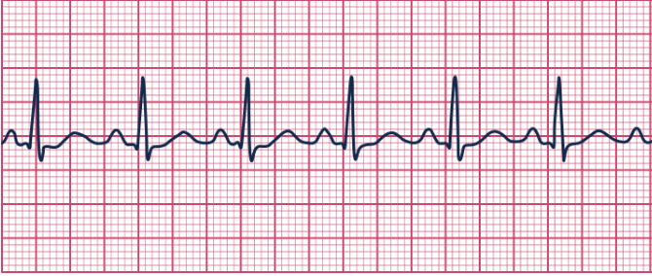
Normal Sinus Rhythm
Definition: The physiological rhythm originating from the SA node, conducting normally through the heart. Represents the baseline healthy electrical activity.
ECG Characteristics :
Rate: 60-100 bpm (adults at rest).
Rhythm: Regular (consistent P-P and R-R intervals).
P waves: Uniform morphology, upright in I, II, aVF; inverted in aVR; one P wave precedes each QRS complex.
PR Interval: Constant, 0.12-0.20 seconds.
QRS Duration: Narrow, typically <0.10-0.12 seconds.
P:QRS Ratio: 1:1.
Normal Condition ECG

Slide 5
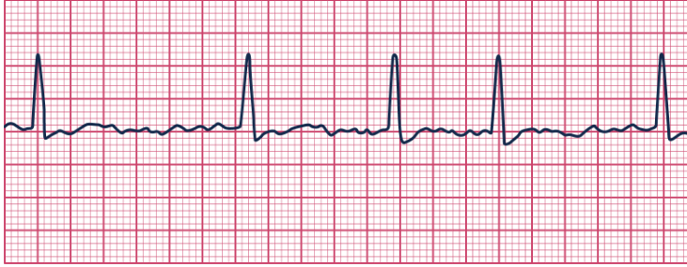
Atrial Fibrillation (AFib)
Definition: AF is a chaotic, multi-wavelet re-entry arrhythmia in the atria. Because hundreds of foci fire simultaneously, organised atrial depolarisation never occurs and the AV node is bombarded by irregular impulses.
ECG Characteristics :
Rhythm / Heart rate: irregularly-irregular ventricular response; most patients with untreated (“rapid-AF”) conduct at ≈ 110 – 160 bpm, but the atrial mass is really firing chaotically at ≈ 350 – 600 bpm.
P waves: no discrete P waves; coarse or fine fibrillatory (f) waves replace the isoelectric line.
P : QRS ratio: none (AV node receives a barrage of impulses).
PR interval: not measurable.
QRS duration: usually < 120 ms; will widen only if a pre-existing bundle-branch block or rate-related aberrancy is present.
Normal Condition ECG
Atrial Fibrillation

Slide 6
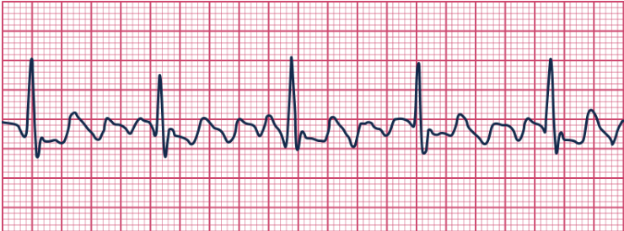
Atrial Flutter
Definition: Rapid but organized atrial electrical activity, typically from a large re-entrant circuit (usually in the right atrium).
ECG Characteristics:
Atrial rate: ~300 bpm (range 240 – 350)
Ventricular rate: Determined by the AV block ratio
2 : 1 block ⇒ ≈ 150 bpm (most common)
3 : 1 block ⇒ ≈ 100 bpm, etc.
P waves: Absent; replaced by saw-tooth flutter (F) waves best seen in leads II, III, aVF
P : QRS ratio: Typically 2 : 1 but may be 3 : 1, 4 : 1 or variable
PR interval: Not measurable (no discrete P waves)
QRS duration: < 120 ms unless concurrent bundle-branch block
Normal Condition ECG
Atrial Flutter

Slide 7
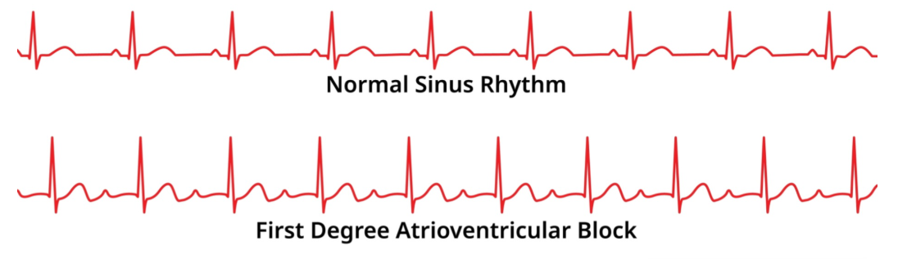
First-Degree Atrioventricular (AV) Block
Definition: Sinus impulses reach the ventricles, but conduction through the AV node or His bundle is slowed, so every beat is delayed but none are dropped.
ECG Characteristics:
Heart rate: Normal sinus rate (60 – 100 bpm) unless another rhythm abnormality co-exists
P waves: Normal morphology; every P followed by QRS
P : QRS ratio: 1 : 1
PR interval: Prolonged > 200 ms (≥ 5 small squares), constant from beat to beat
QRS duration: Normal (< 120 ms)
Normal Condition ECG

Slide 8
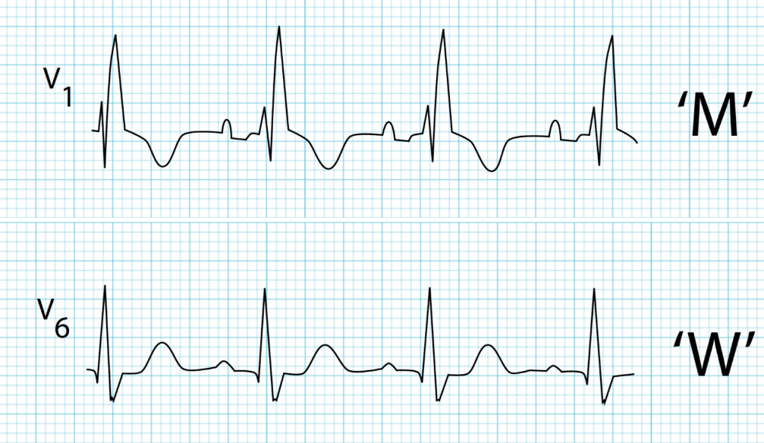
Right Bundle-Branch Block (RBBB)
Definition: In RBBB, activation of the right ventricle must spread from the left, so right-sided depolarisation is delayed.
ECG Characteristics:
Heart rate & P waves: Determined by the underlying rhythm (often normal sinus)
PR interval: Normal unless another AV-nodal disorder co-exists
QRS duration: ≥ 120 ms
Morphology:
rSR′ or “M-shaped” QRS in V₁–V₃
Broad, slurred S-wave in leads I, aVL, V₅–V₆
P : QRS ratio: 1 : 1 (conduction block is infranodal)
Normal Condition ECG
RBBB

Slide 9
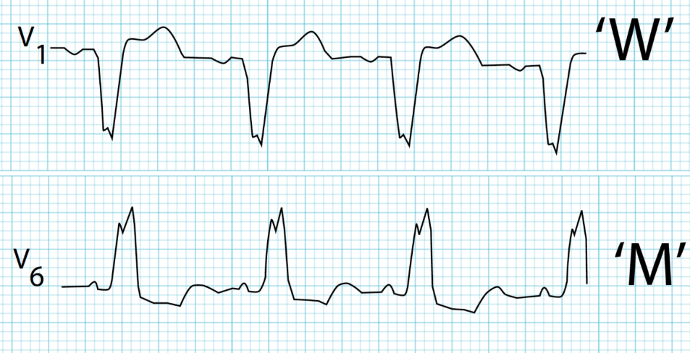
Left Bundle-Branch Block (LBBB)
Definition: In LBBB, the left ventricular conduction system is blocked, so depolarisation proceeds from right to left across the septum, greatly widening the QRS.
ECG Characteristics:
Heart rate & P waves: Depend on underlying rhythm (usually sinus)
PR interval: Normal unless concurrent AV-nodal disease
QRS duration: ≥ 120 ms with distinctive shape
Morphology:
Deep, broad S-wave (or QS) in V₁–V₂
Broad, often notched R-wave in V₅–V₆, I, aVL
“Appropriate discordance” – ST/T changes opposite the major QRS deflection
P : QRS ratio: 1 : 1
Normal Condition ECG
LBBB

Slide 10
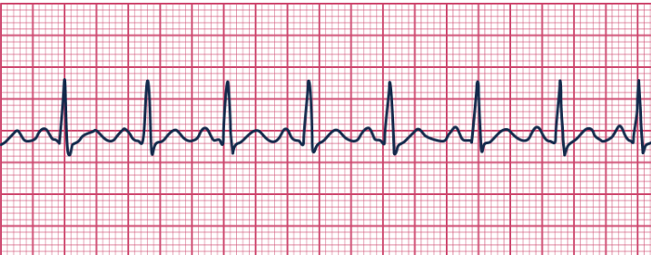
Sinus Tachycardia
Definition: A sinus rhythm with a heart rate exceeding the normal upper limit, typically >100 bpm in adults.
ECG Characteristics :
Meets all criteria for Normal Sinus Rhythm (regular, normal P waves, 1:1 P:QRS, constant normal PR, narrow QRS) EXCEPT:
Rate: >100 bpm.
Note: At very high rates, P waves may merge with the preceding T wave.
Normal Condition ECG
Sinus Tachycardia

Slide 11
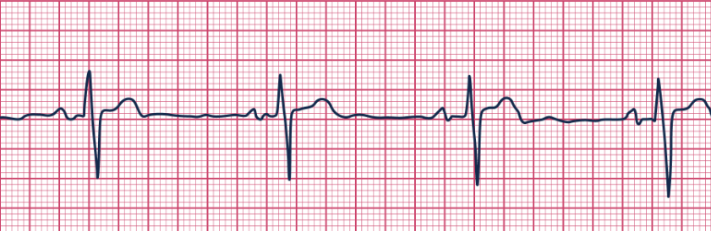
Sinus Bradycardia
Definition: A sinus rhythm with a heart rate below the normal lower limit, typically <60 bpm (sometimes defined as <50 bpm).
ECG Characteristics :
Meets all criteria for Normal Sinus Rhythm (regular, normal P waves, 1:1 P:QRS, constant normal PR, narrow QRS) EXCEPT:
Rate: <60 bpm (or <50 bpm).
Normal Condition ECG
Sinus Bradycardia

Slide 12
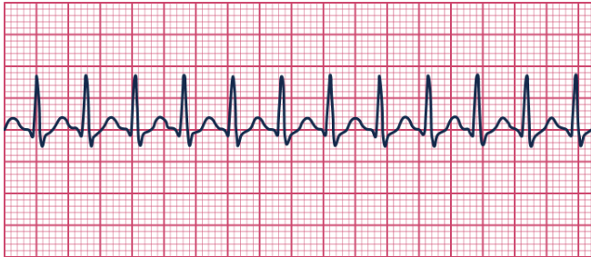
Supraventricular Tachycardia (SVT) - Regular Types
Definition: Tachyarrhythmias originating above the His bundle bifurcation; often used for regular, narrow-complex tachycardias like AVNRT and AVRT.
ECG Characteristics (Typical AVNRT/AVRT) :
Rate: Rapid, typically 150-220 bpm.
Rhythm: Very regular.
P waves: Often difficult to see; may be buried in QRS, distort the end of the QRS (pseudo R' in V1, pseudo S in inferior), or occur just after the QRS (retrograde).
PR Interval: Often not measurable or short if abnormal P precedes QRS (some Atrial Tachycardias).
QRS Duration: Usually narrow (<0.12s).
Normal Condition ECG
Supraventricular Tachycardia

Slide 13
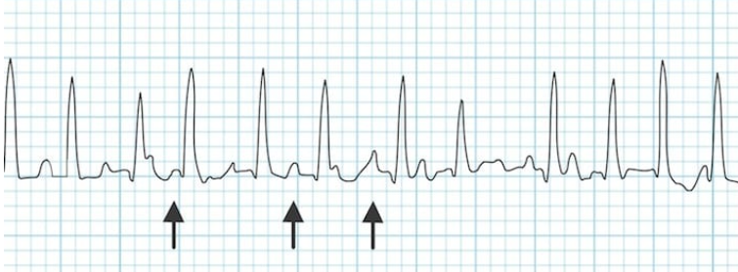
Multifocal Atrial Tachycardia (MAT)
Definition: An irregular SVT caused by random firing of multiple ectopic foci within the atria.
ECG Characteristics :
Rate: Atrial and ventricular rate >100 bpm.
Rhythm: Irregularly irregular ventricular rhythm.
P waves: Hallmark: At least 3 different P wave morphologies in the same lead; each QRS preceded by one of these P waves. Discernible isoelectric baseline between P waves.
PR Interval: Variable.
QRS Duration: Usually narrow (<0.12s).
Normal Condition ECG
Multifocal Atrial Tachycardia (MAT)

Slide 14
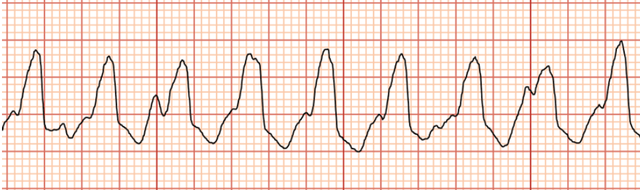
Monomorphic Ventricular Tachycardia (VT)
Slide 13: Monomorphic Ventricular Tachycardia (VT)
Definition: ≥3 consecutive ventricular beats at >100 bpm, where all QRS complexes have the same morphology.
ECG Characteristics :
Rate: Typically 100-250 bpm.
Rhythm: Usually regular (or very nearly regular).
P waves: Usually dissociated from QRS complexes (AV dissociation); sinus P waves may march through.
QRS Duration: Wide (≥0.12 seconds).
QRS Morphology: Uniform, bizarre wide complexes for the duration of the tachycardia.
Normal Condition ECG
Monomorphic Ventricular Tachycardia (VT)

Slide 15
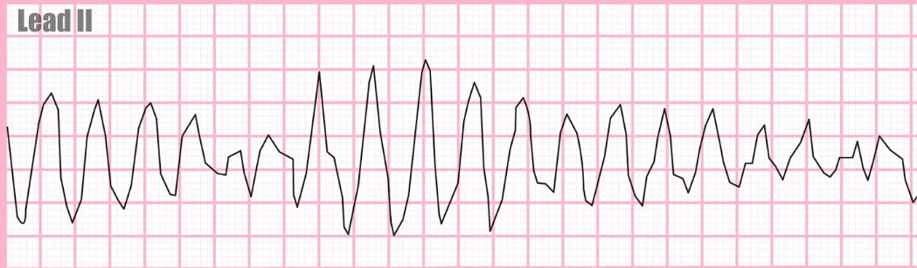
Polymorphic Ventricular Tachycardia (VT)
Definition: VT where the QRS morphology continuously changes from beat to beat.
ECG Characteristics :
Rate: Typically >150 bpm.
Rhythm: Often irregular due to changing morphology.
P waves: Usually dissociated (AV dissociation).
QRS Duration: Wide (≥0.12 seconds).
QRS Morphology: Continuously varying wide complexes, may appear to twist around the baseline (characteristic of Torsades de Pointes if associated with long QT).
Normal Condition ECG
Polymorphic Ventricular Tachycardia (VT)

Slide 16
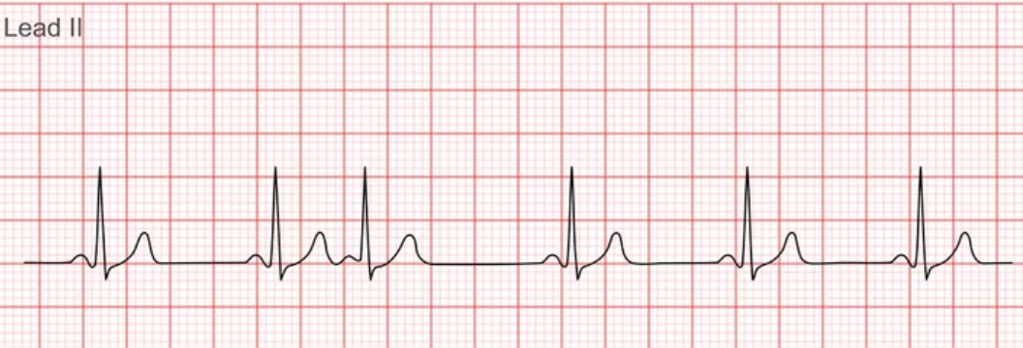
Premature Atrial Contractions (PACs)
Definition: Ectopic beats originating from an atrial focus outside the SA node, occurring earlier than the next expected sinus beat.
ECG Characteristics:
Rhythm: Underlying rhythm interrupted by premature beat(s).
P wave: Occurs early; morphology differs from sinus P waves; may be hidden in preceding T wave.
PR Interval: Can be normal, short, prolonged, or the PAC may be blocked (P wave with no QRS).
QRS Duration: Usually narrow (like sinus beats); can be wide if conducted aberrantly.
Pause: Typically followed by a non-compensatory pause.
Normal Condition ECG
Premature Atrial Contractions (PACs)

Slide 17
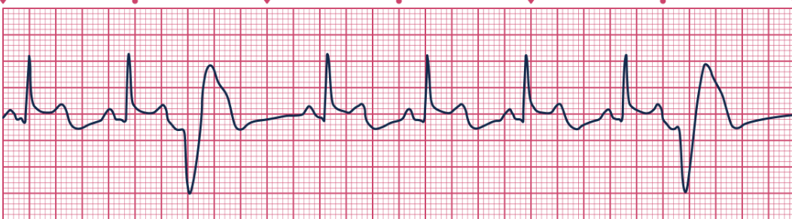
Premature Ventricular Contractions (PVCs)
Definition: Ectopic beats originating from a focus within the ventricles, occurring earlier than the next expected sinus beat.
ECG Characteristics :
Rhythm: Underlying rhythm interrupted by premature beat(s).
P wave: Usually absent before the PVC; dissociated sinus P waves may occur nearby.
QRS Duration (of PVC): Wide (≥0.12 seconds).
QRS Morphology (of PVC): Bizarre, differs from sinus beats.
ST-T wave: Discordant (opposite direction to main QRS vector).
Pause: Typically followed by a full compensatory pause.
Normal Condition ECG
Premature Ventricular Contractions (PVCs)

Slide 18
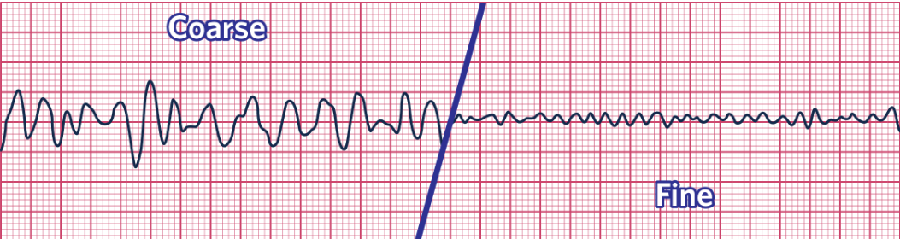
Ventricular Fibrillation (VFib)
Definition: Completely disorganized, chaotic electrical activity in the ventricles, resulting in no effective cardiac output.
ECG Characteristics :
Rate: Indeterminable.
Rhythm: Chaotic, disorganized, irregular.
P waves: Absent.
PR Interval: Absent.
QRS Complexes: Absent; replaced by irregular, shapeless fibrillatory waves varying in amplitude and morphology (coarse or fine).
Normal Condition ECG
Ventricular Fibrillation

Slide 19
HuBERT-ECG - Overview & Architecture
What it is: A self-supervised foundation model designed for general-purpose analysis of 12-lead ECGs.
Goal: To overcome the limitations of task-specific AI models by learning robust, transferable ECG representations from vast amounts of data.
Pre-training:
Utilizes self-supervised learning (SSL) on a large, diverse dataset of 9.1 million ECGs from multiple sources.
Employs a masked prediction task: the model learns to predict pseudo-labels (derived from clustering ECG fragments) for masked portions of the ECG signal.
Architecture:
Based on the HuBERT model (successful in speech processing).
Core component: Transformer encoder to capture global context and long-range dependencies in the ECG sequence.
Input Layer: Convolutional embedder adapted for ECG characteristics processes the raw signal.
Model Sizes: Available in SMALL (~30M params), BASE (~93M params), and LARGE (~188M params) configurations to balance performance and computational needs.

Slide 20
HuBERT-ECG - Performance, Strengths & Limitations
Performance:
Achieves high diagnostic accuracy (often >90-95% AUROC) across a wide range of benchmark datasets and 164 cardiovascular conditions after fine-tuning.
Demonstrates potential for predicting future cardiovascular events (e.g., 2-year mortality in Chagas disease, AUROC 93.4% after broad fine-tuning).
Key Strengths:
Strong Diagnostic Capability: Effective across many conditions.
Sample Efficiency: Performs well even with limited labeled data for fine-tuning, outperforming models trained from scratch.
Versatility: Adaptable to various downstream tasks (diagnosis, prediction).
Open-Sourced: Pre-trained models and code are publicly released, fostering reproducibility.
Limitations & Challenges:
Data Gaps: Pre-training data lacks representation from key regions like Africa and India, potentially limiting global generalizability.
Bias Concerns: No explicit fairness analysis across demographic groups was reported.
Interpretability: The study lacks discussion on model explainability ("black box" issue).
Clinical Translation: Requires further validation (prospective trials), workflow integration, regulatory approval, and building clinician trust before widespread use.
Overall Significance: A powerful demonstration of foundation models in ECG analysis, offering potential for improved diagnostics, risk stratification, and broader access to ECG interpretation capabilities.

Slide 21
HuBERT-ECG - Cardiovascular Conditions Covered
Atrial fibrillation: Yes
Atrial flutter: Yes
Sinus bradycardia: Yes
Sinus tachycardia: Yes
Supraventricular tachycardia: Yes
Atrioventricular Node Reentrant Tachycardia: Yes
Atrioventricular Reentrant Tachycardia: Yes
Multifocal atrial tachycardia: Yes
Premature atrial contractions: Yes
Monomorphic ventricular tachycardia: Only mention ventricular tachycardia
Polymorphic ventricular tachycardia: Only mention ventricular tachycardia
SVT (supraventricular tachycardia) with aberrancy: No
Premature ventricular contractions: Yes
1st degree AV block:Yes
2nd degree AV block: Yes
3rd degree AV block: Yes
Ventricular fibrillation: Yes

